Slide 1
Hot Topics: Physical Security CS-4440 - Introduction to Computer Security Spring 2022 Jun Xu Slides adapted from Kevin Fu at Umich and Fei Hu at University of Alabama

Slide 2
Comments from Quiz 2
I saw many good comments. Thanks!
Further improvements:
More practices (homework for JX)
Reviews for the Final Exam (suggestion accepted)

Slide 3
Practice 4: Debugging
April 13th, Wednesday
Learn how to debug “malware” (a C program in this course)
You will be given a C program similar to the one in the next page:

Slide 4
Practice 4
#include <stdio.h>
/* Print the sum of the integers from 1 to 1000 */
int main(int argc, char **argv) {
int i;
int sum;
sum = 0;
for(i = 0; i -= 1000; i++) {
sum += i;
}
printf("%d\n", sum);
return 0;
}

Slide 5
Practice 4: Preparations
Prepare a Linux environment where ”gdb” is installed and available
Windows and MacOS are not disallowed, but their debuggers are harder to set up and use; in addition, materials in this course will be based on Linux (sorry)
Compile the previous example to support debugging (e.g., the source file is called “example.c” and you want to build a program called “prog”):
gcc -O0 -g -no-pie example.c -o prog

Slide 6
Practice 4: Preparations
Able to run the following things
Start the program inside gdb
Set up breakpoints at specific functions, source code locations, or instruction addresses
Execute the program by single steps and single instructions
Print the values in registers, memory locations, and variables
Examine the stack trace and the stack frames
Disassemble functions

Slide 7
Practice 4: Tutorials
https://www.cs.umd.edu/~srhuang/teaching/cmsc212/gdb-tutorial-handout.pdf
https://www.cprogramming.com/gdb.html
https://csiflabs.cs.ucdavis.edu/~ssdavis/30/gdb_Tutorial.htm

Slide 8
Focus Today
Security issues faced by physical devices coupled with computers

Slide 9
Let’s Get a bit of Sense First
https://www.nytimes.com/video/multimedia/1247464146747/mobile-phone-turns-on-oven.html

Slide 10
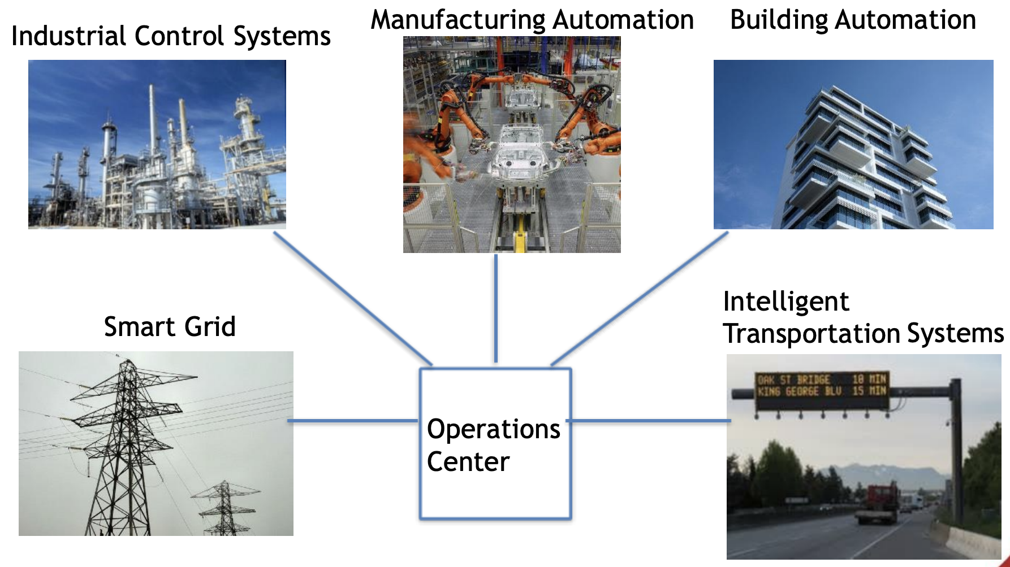
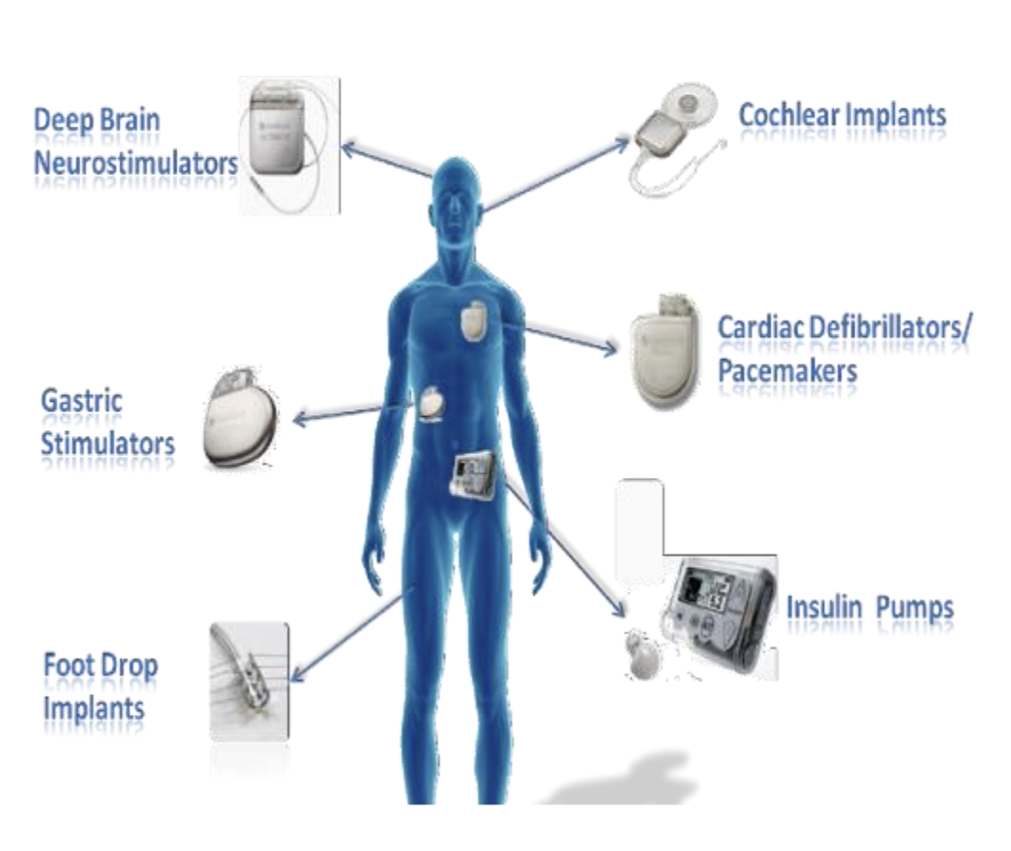
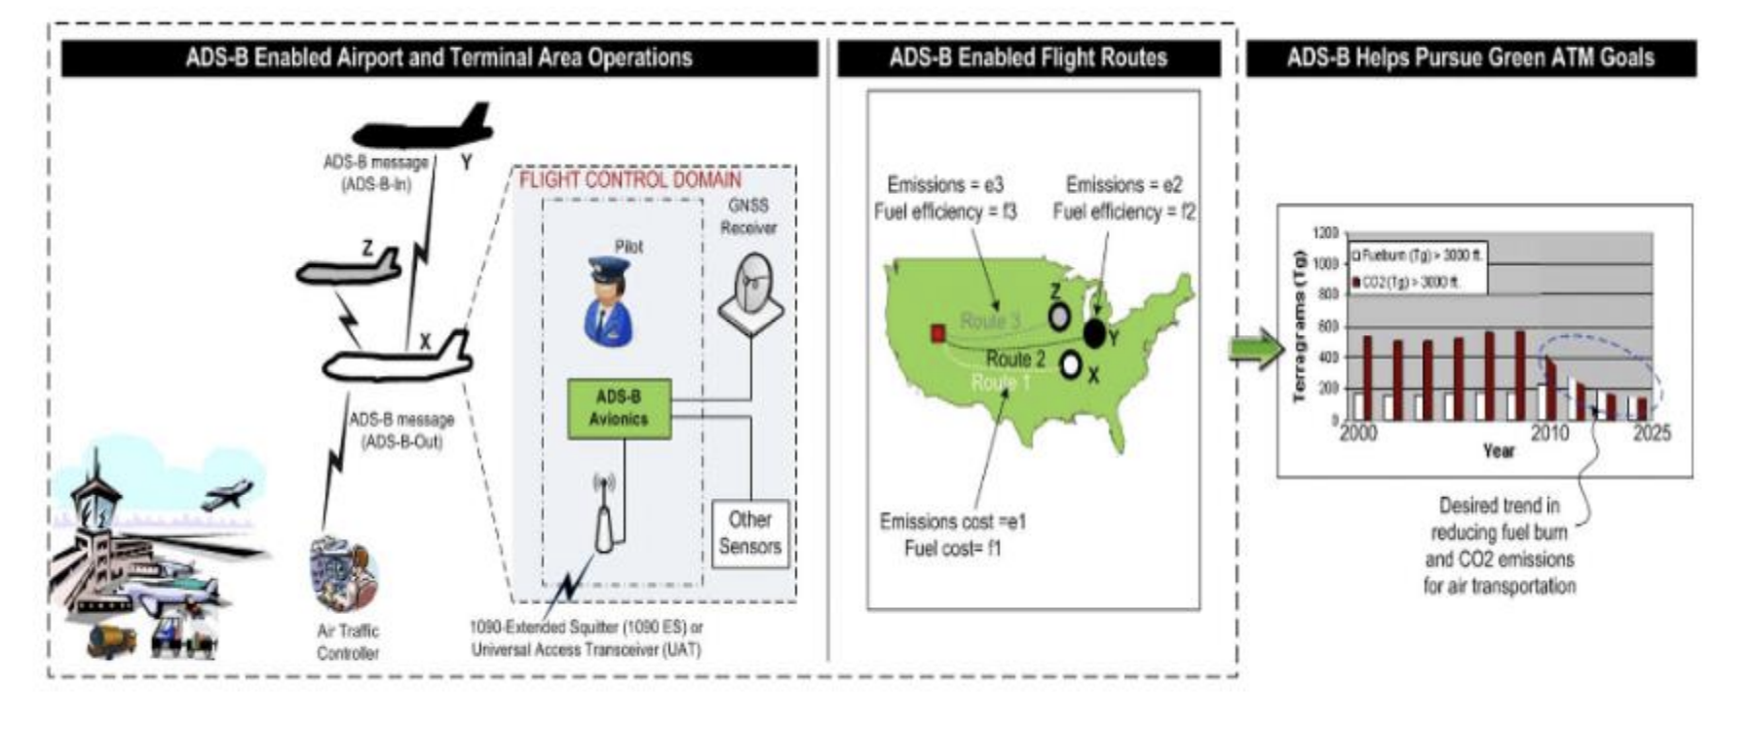
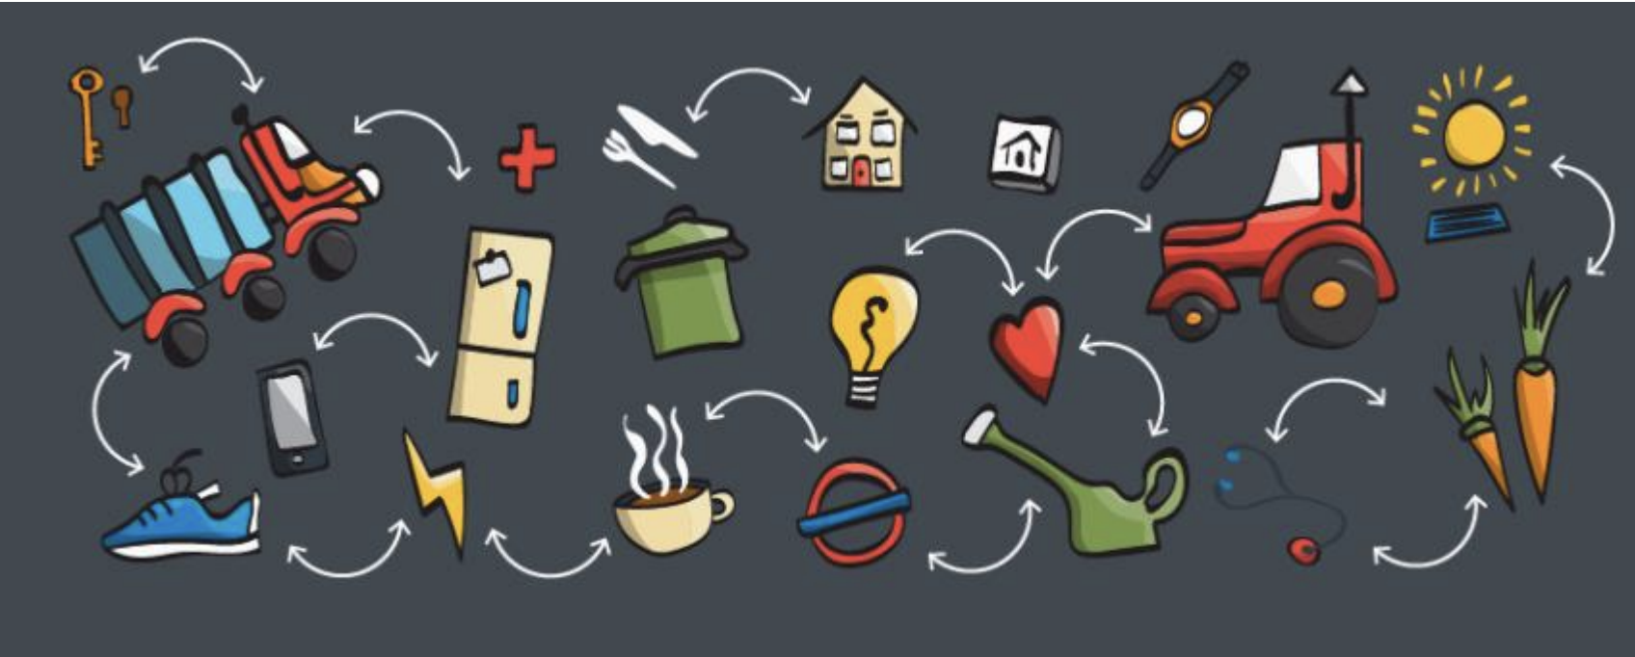
Why physical security matters more today

Slide 11
A Holistic View

Slide 12
Common Types of Security & Privacy Issues
Sensor Security

Slide 13
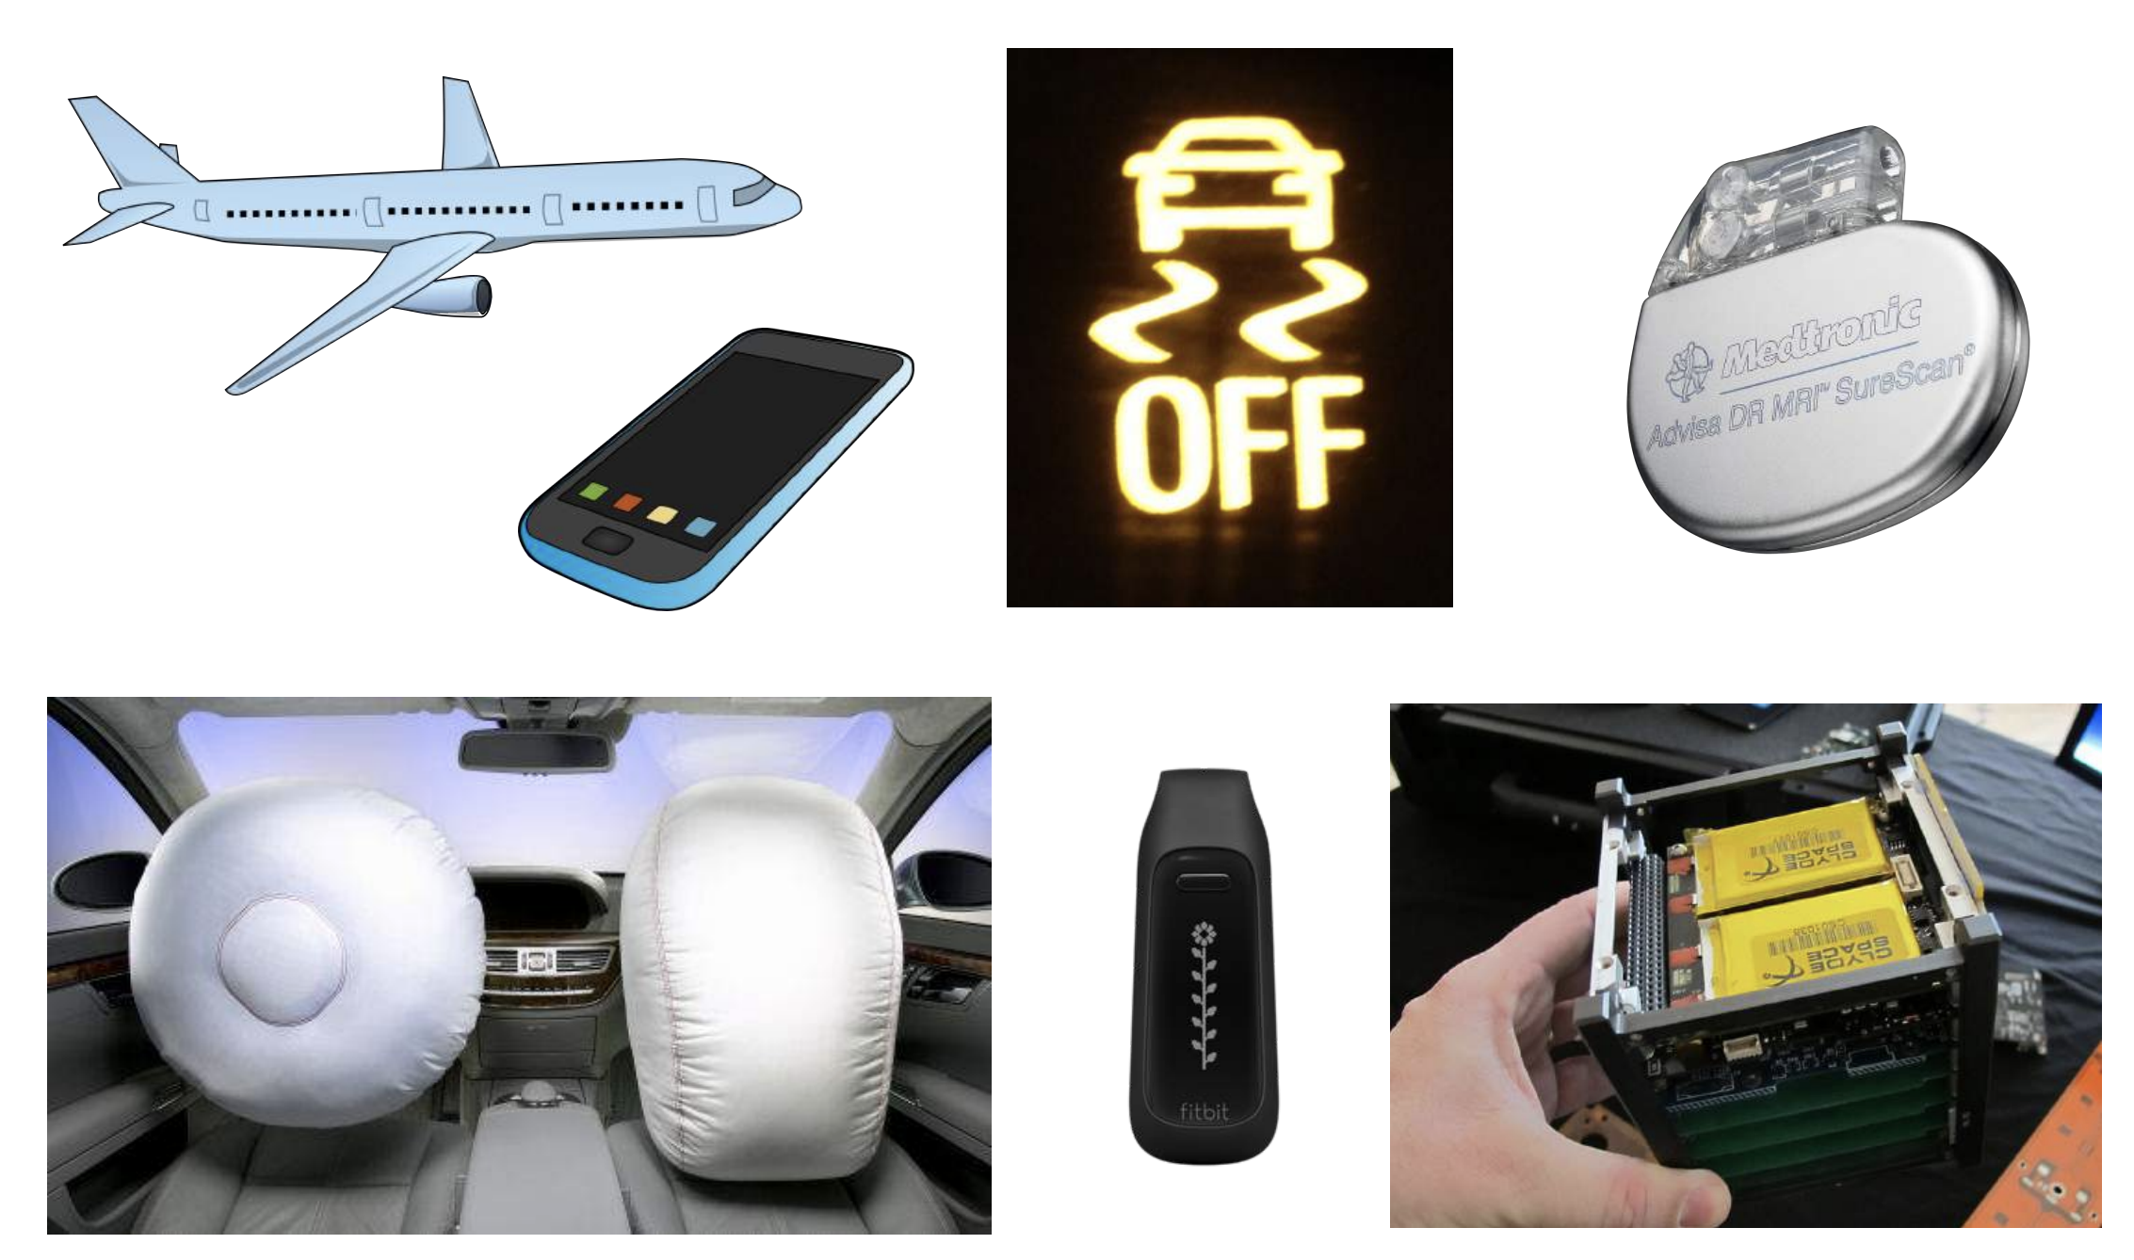
Sensors are Everywhere

Slide 14
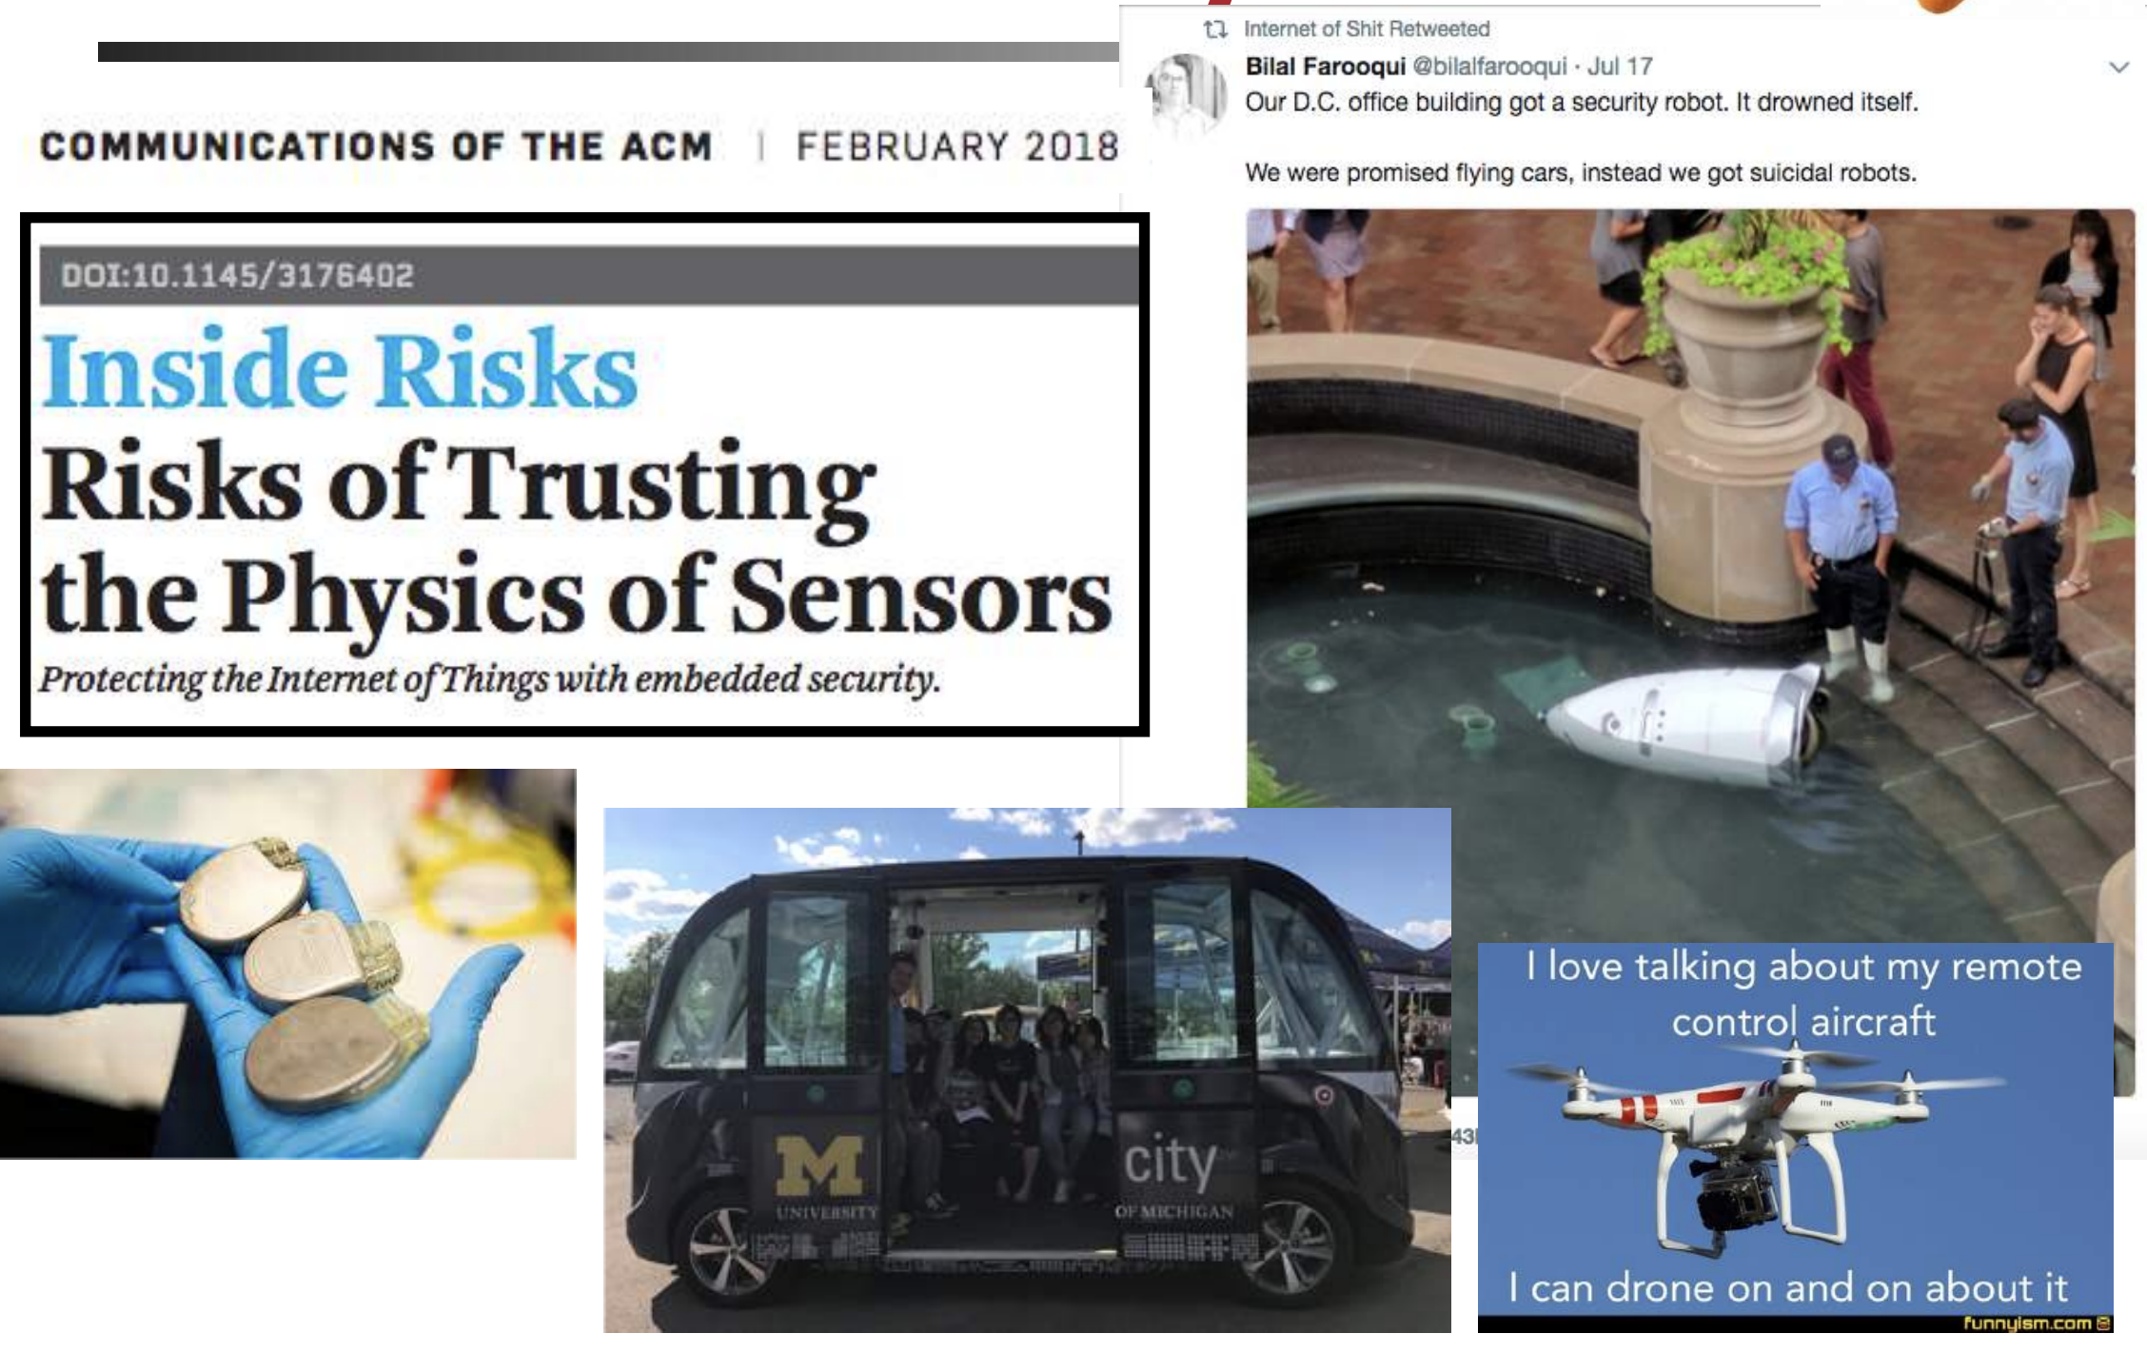
But Sensors are often …

Slide 15
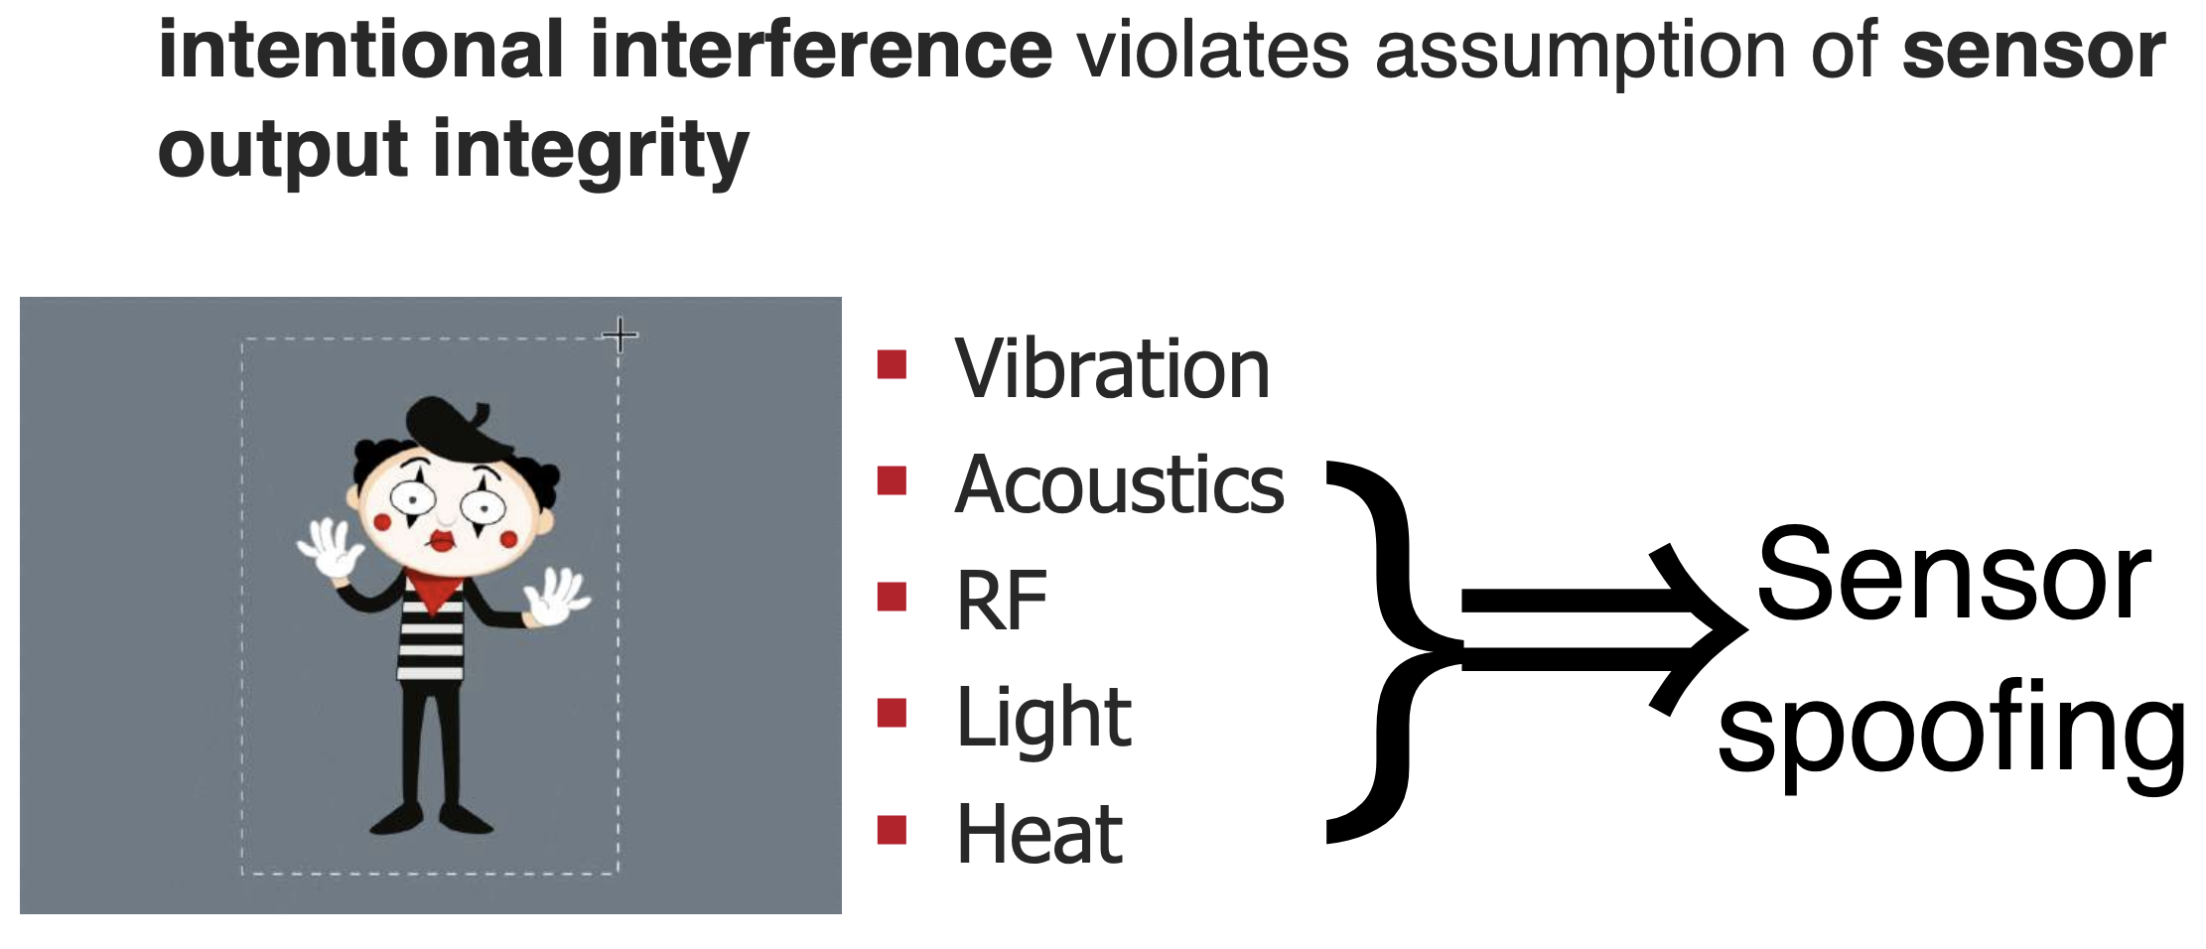
Sensors Can Also Turn into Attack Surfaces

Slide 16
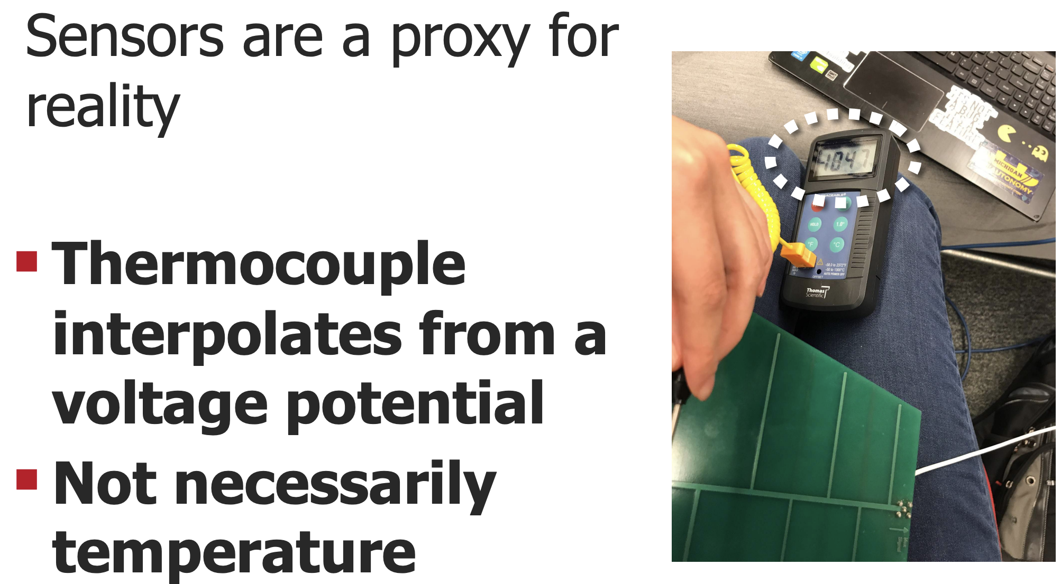
Example 1: Thermocouple

Slide 17
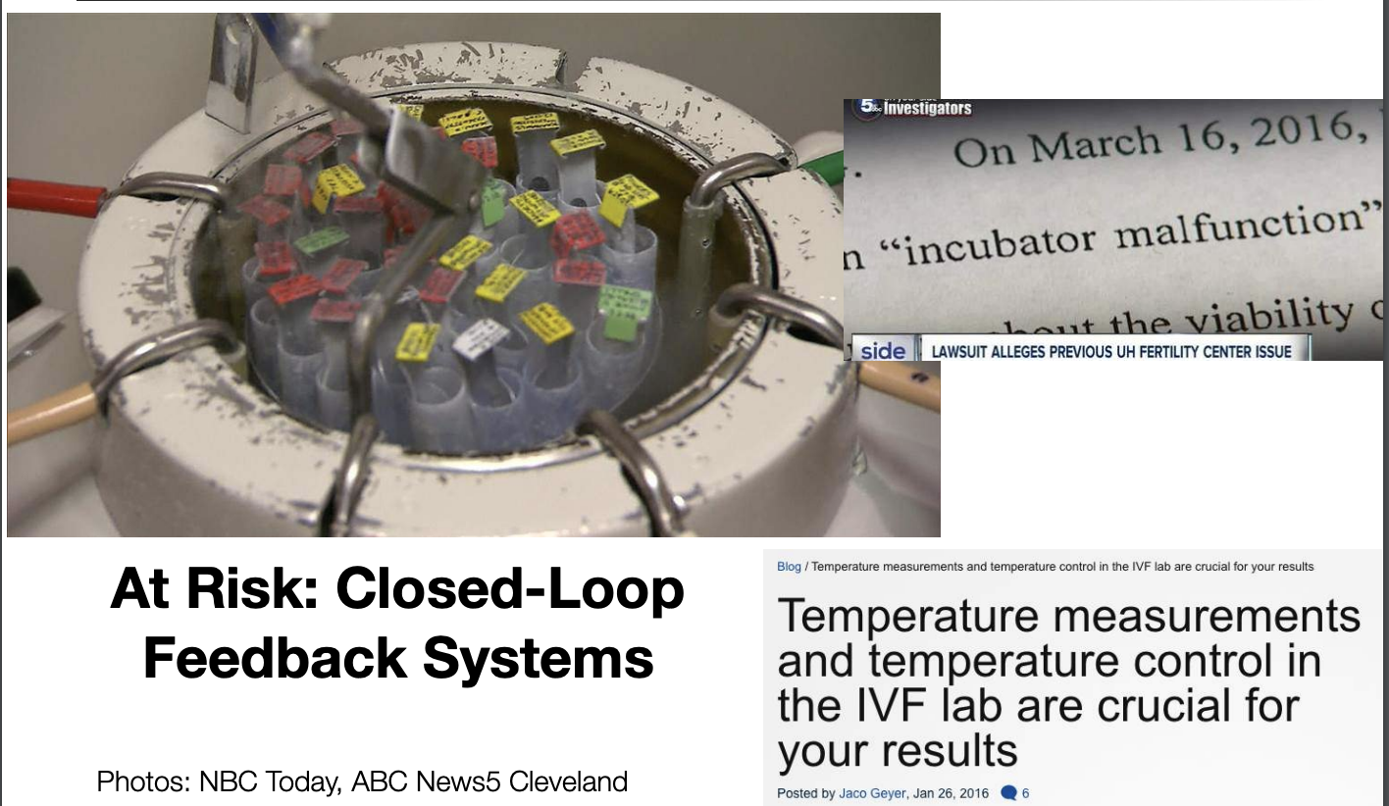
Example 1: Thermocouple (Why It matters)

Slide 18
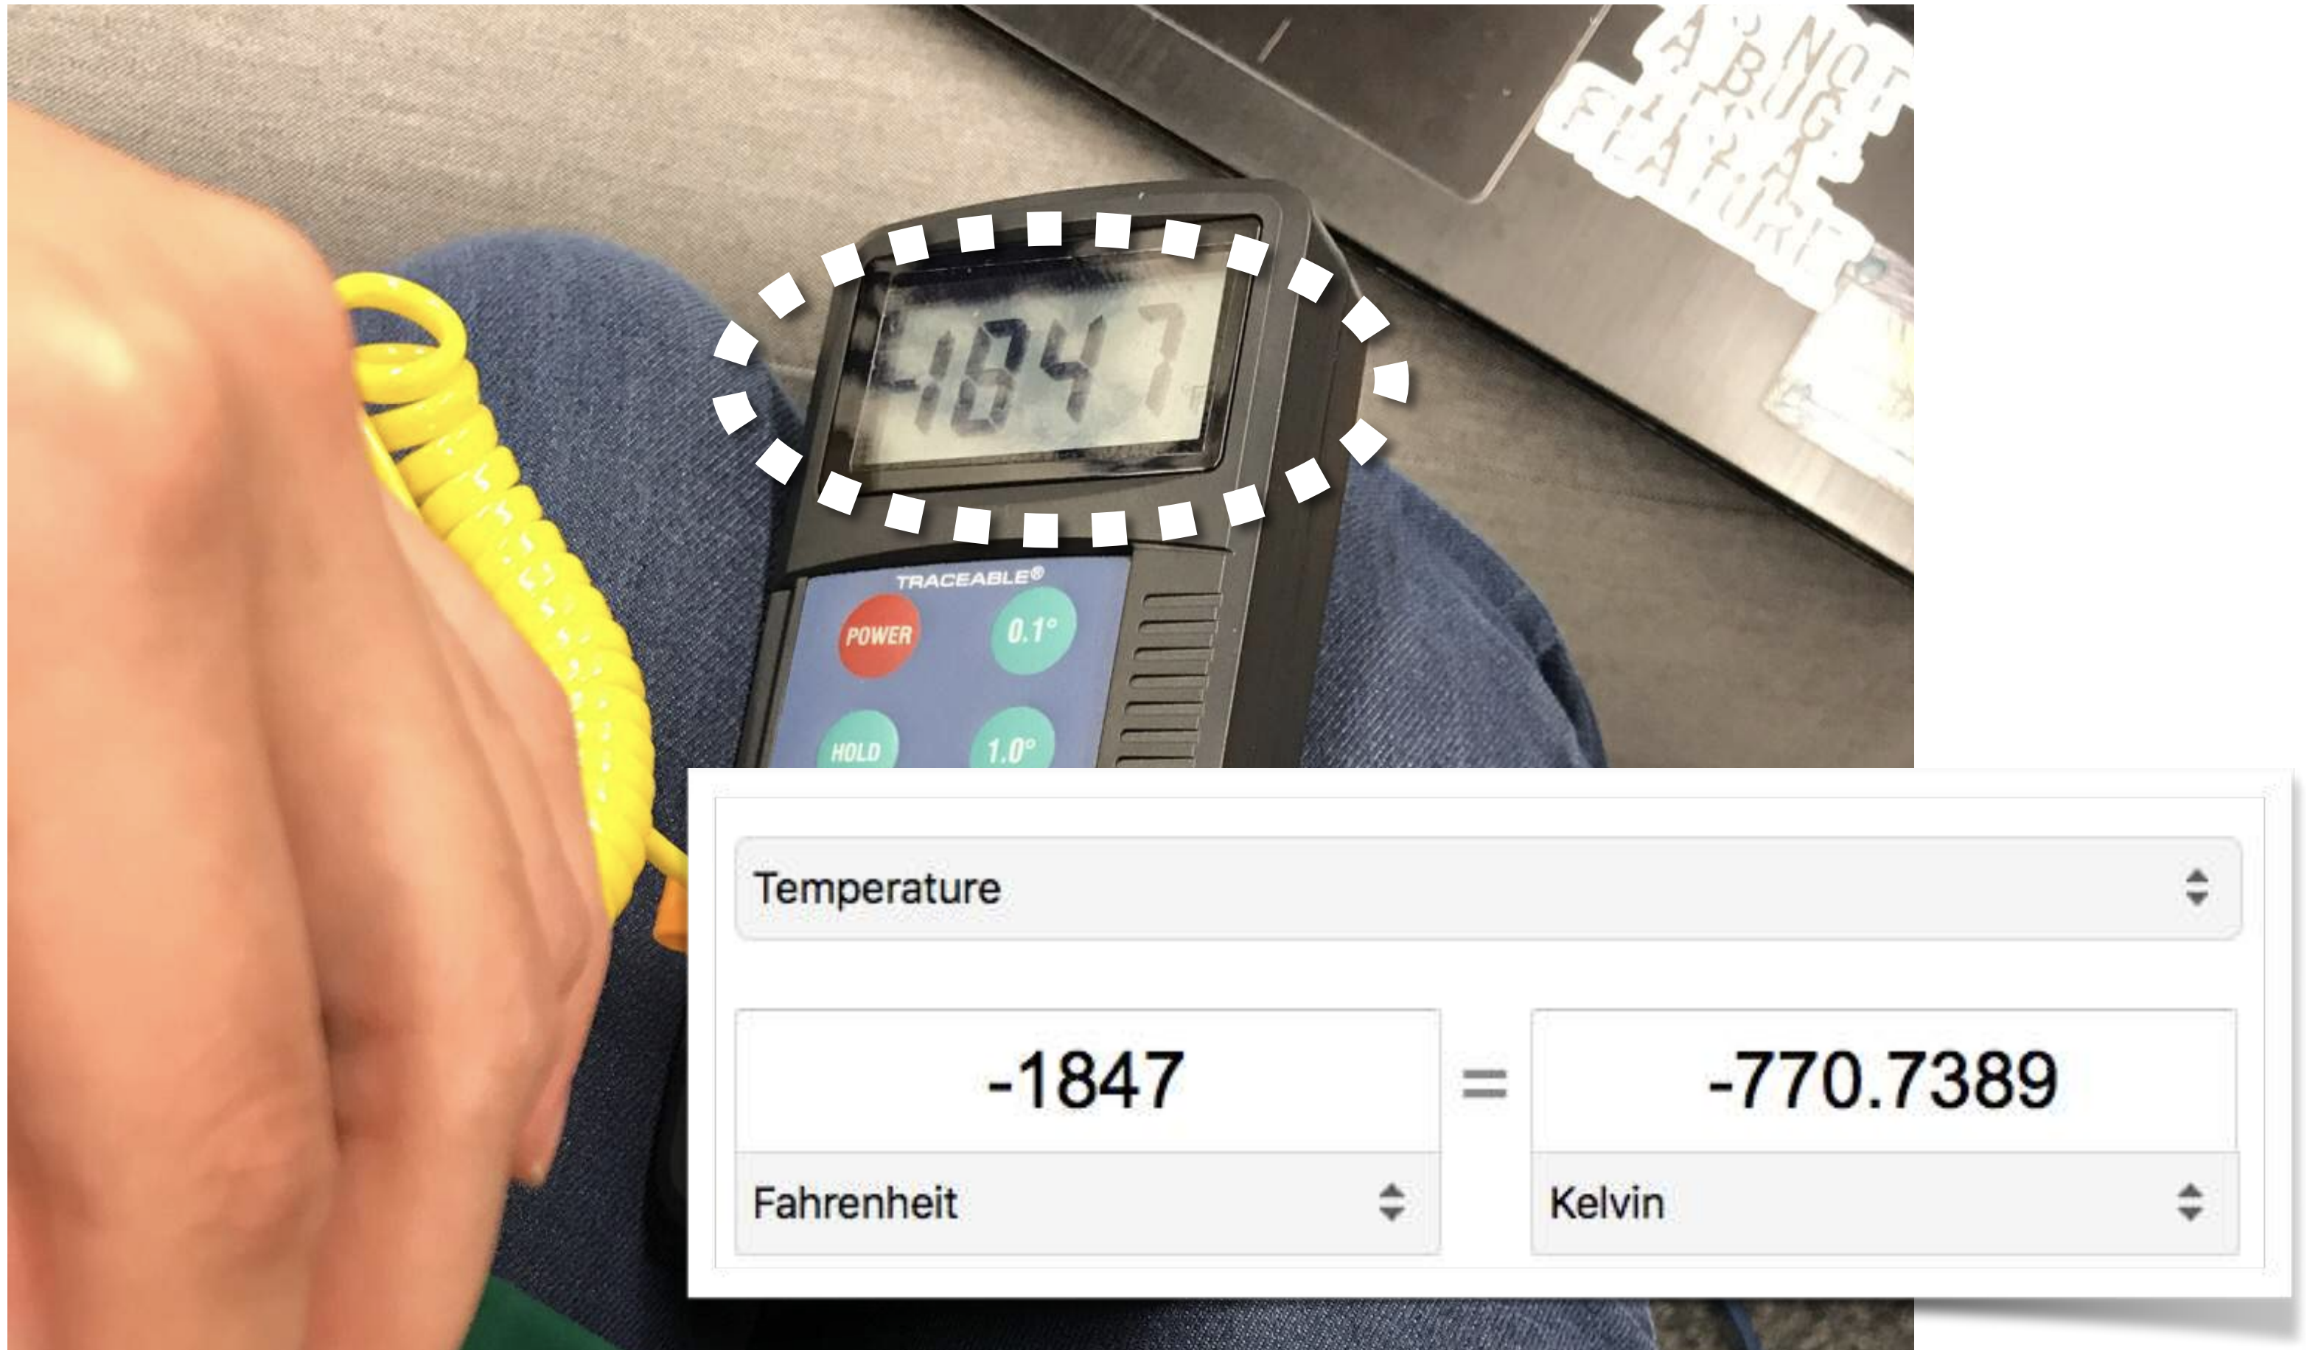
Example 1: Thermocouple: Attacks

Slide 19
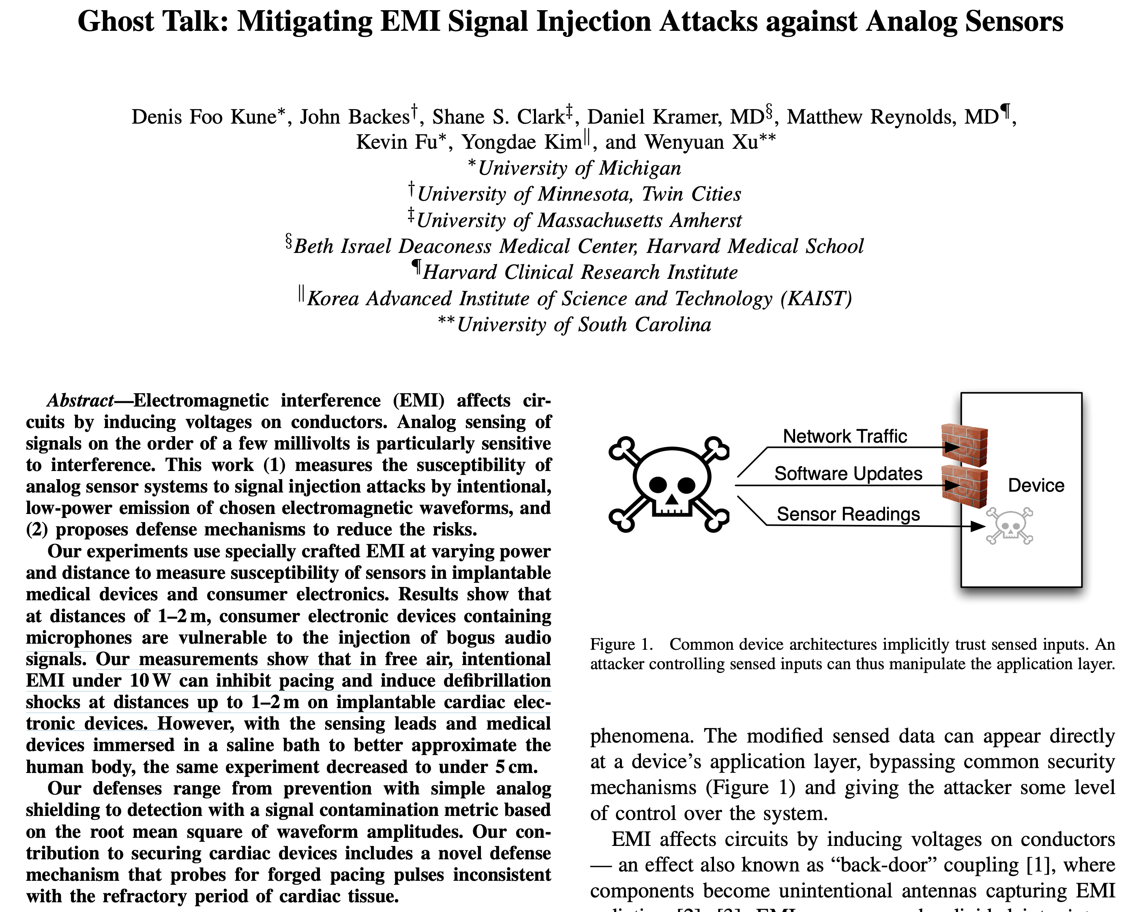
Example 2: Implantable Medical Devices
“Our measurements show that in free air, intentional Electromagnetic interference (EMI) under 10W can inhibit pacing and induce defibrillation shocks at distances up to 1–2 m on implantable cardiac electronic devices”

Slide 20
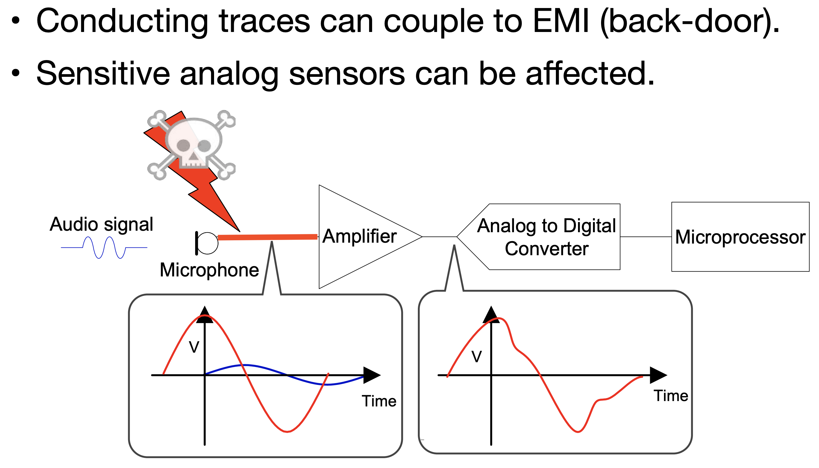
What Happens Behind

Slide 21
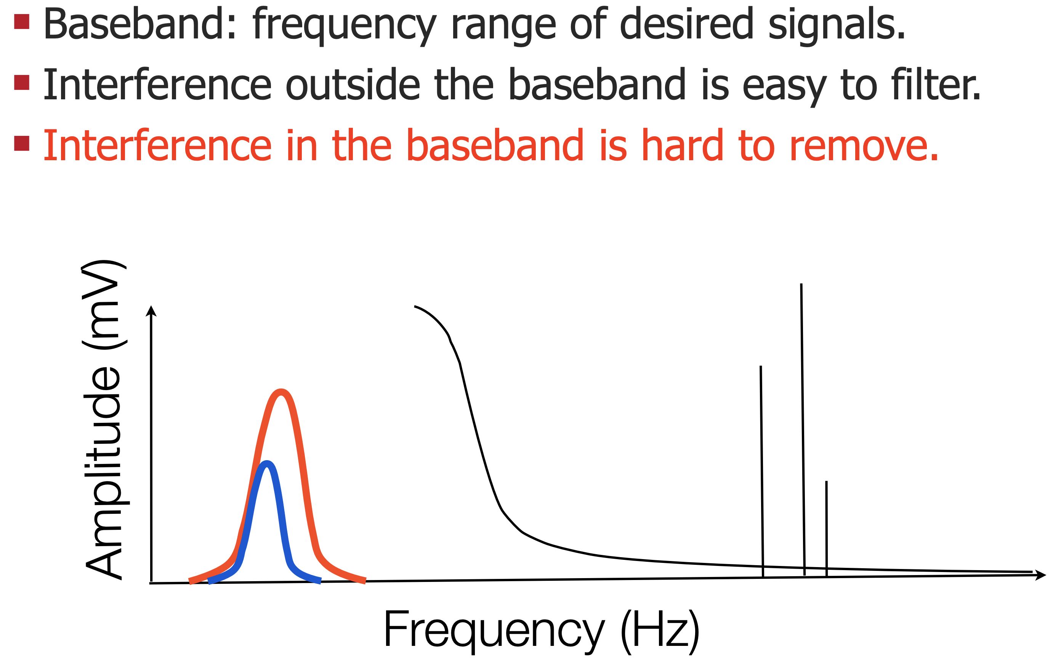
The Fundamental Problem

Slide 22
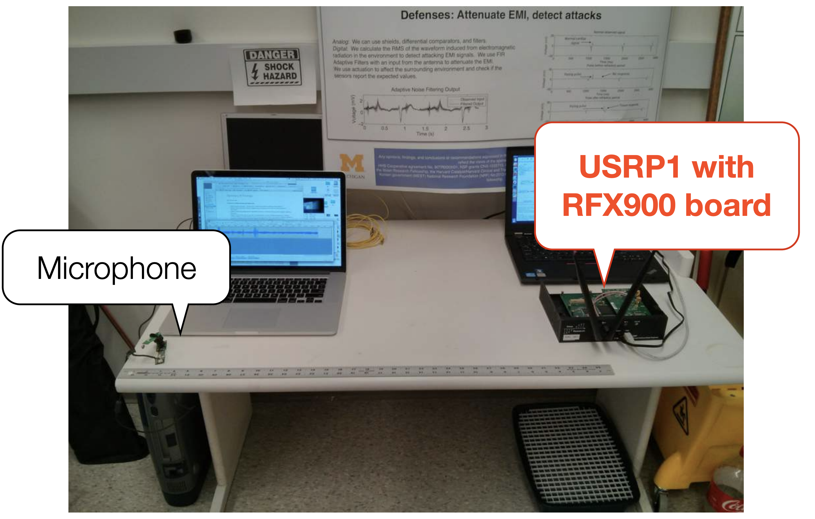
Microphone Interference with RF

Slide 23
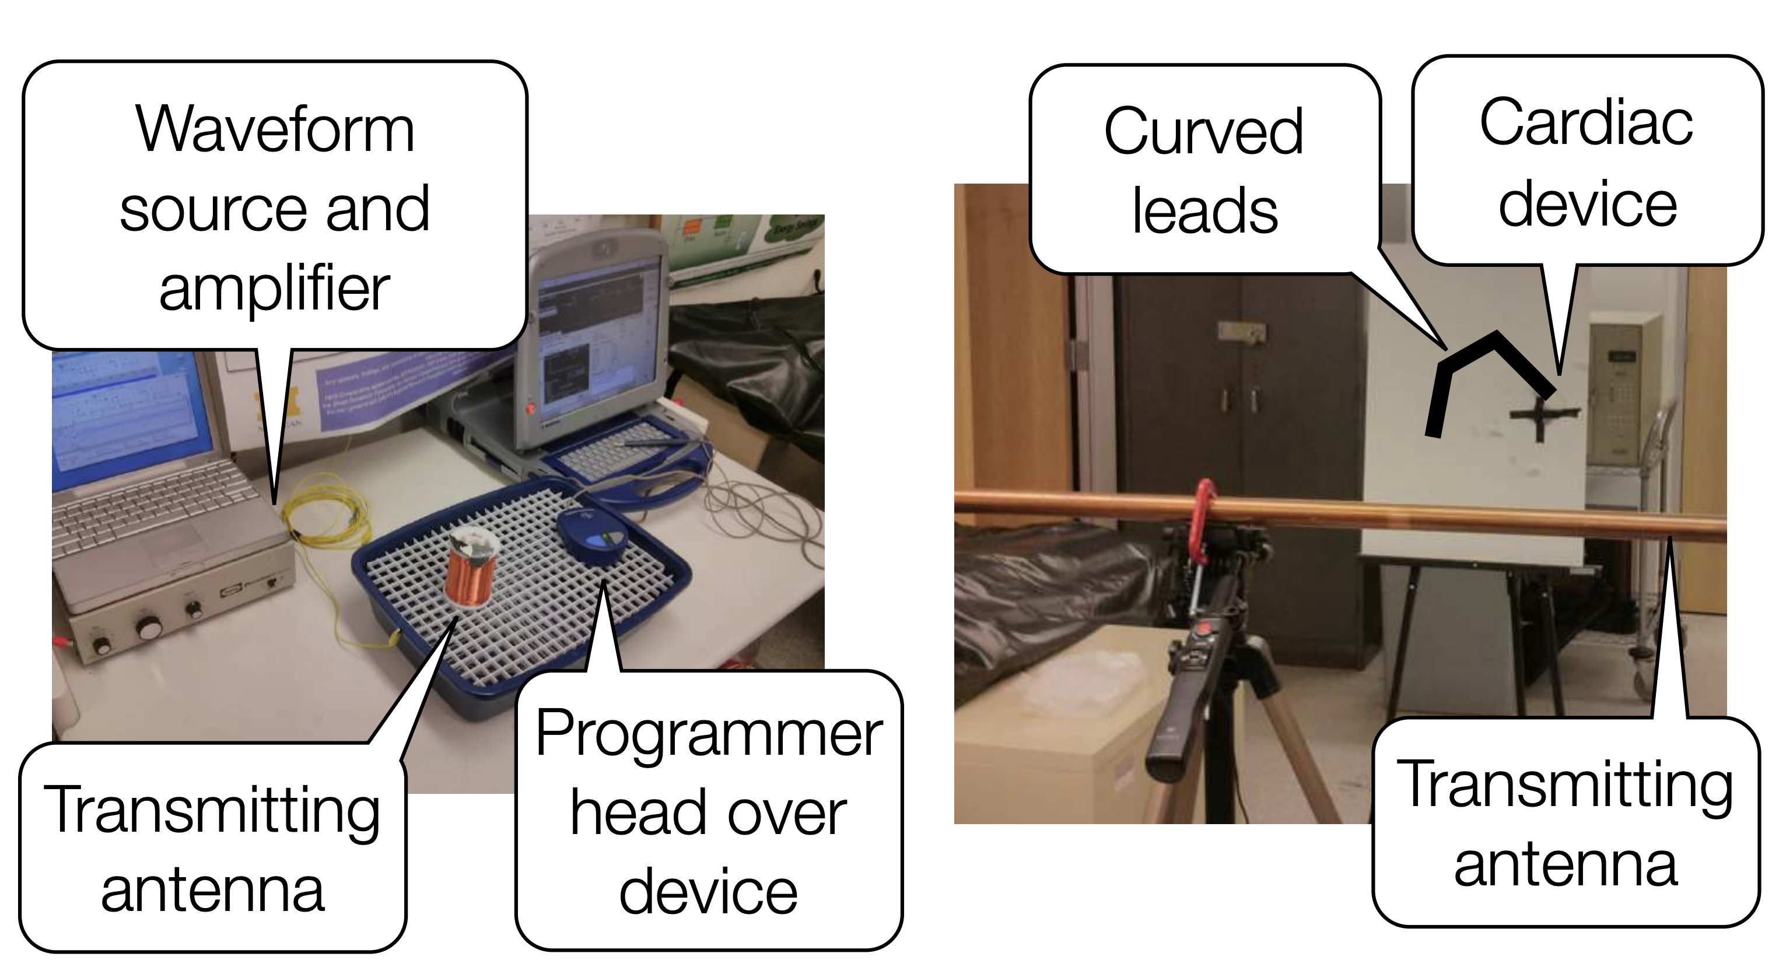
Attacks on Implantable Cardiac Electronic Devices

Slide 24
Common Types of Security & Privacy Issues
Sensor Security
Acoustic Security

Slide 25
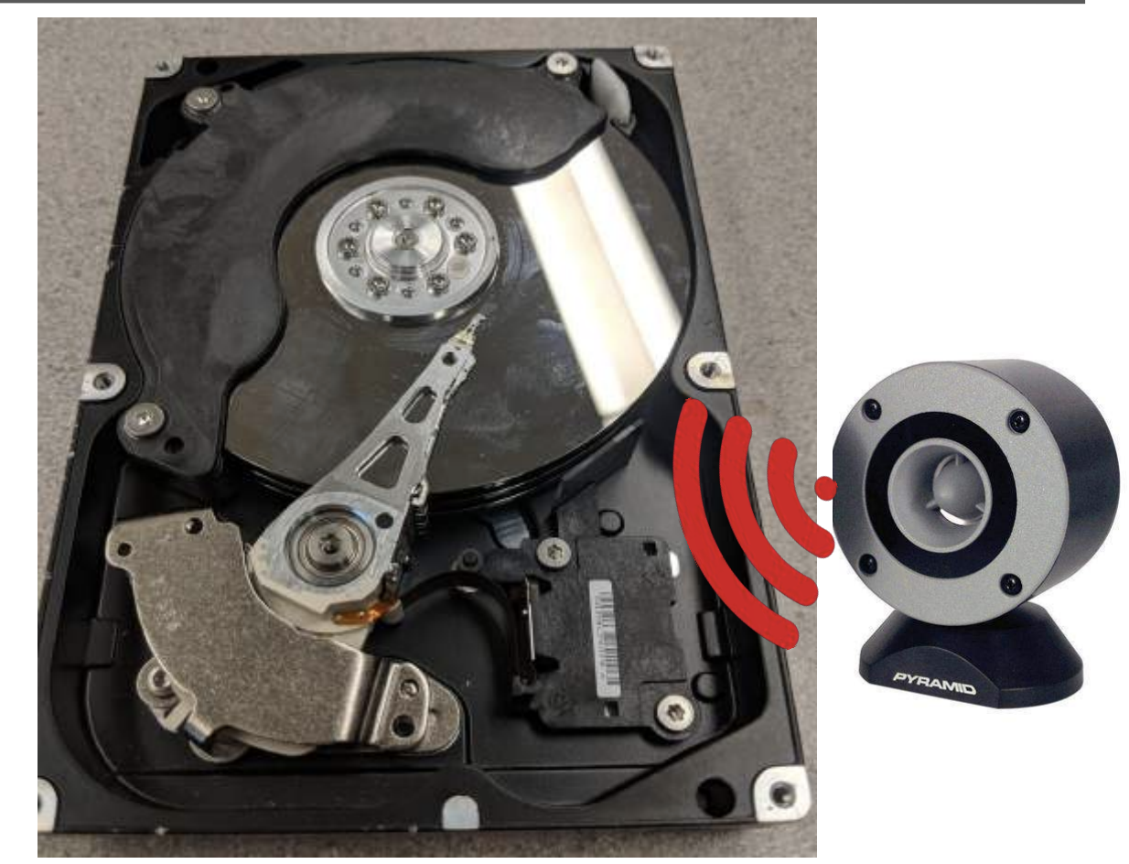
Example 3: Sounds Affecting HDDs
https://www.youtube.com/watch?v=tDacjrSCeq4

Slide 26
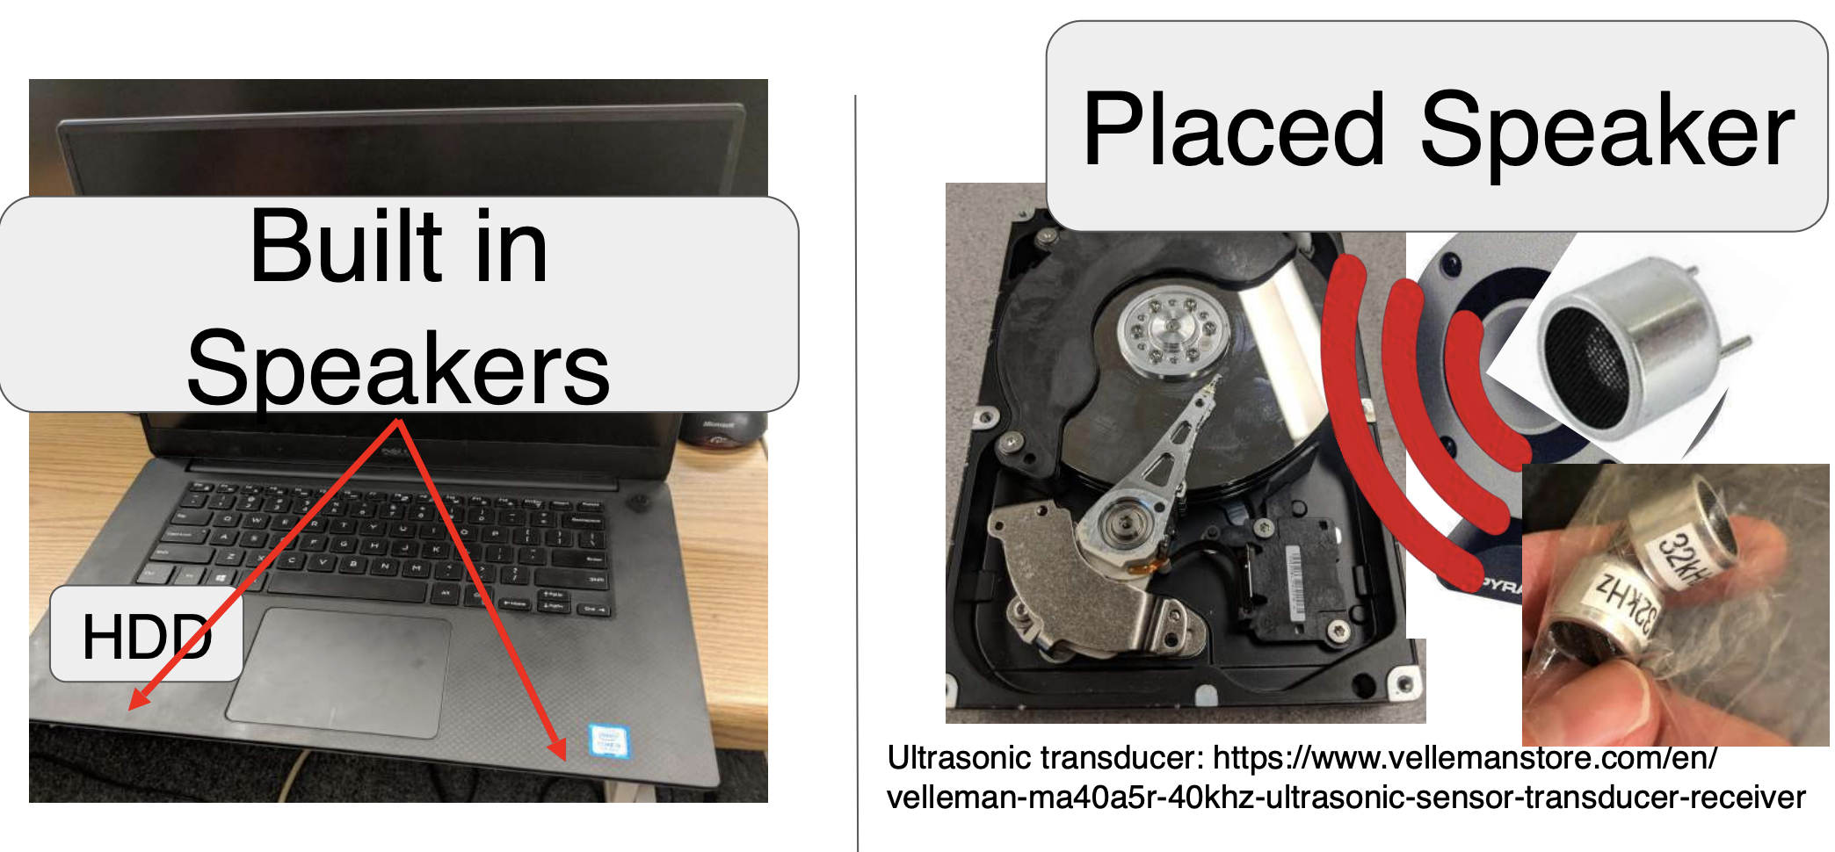
Attack Models

Slide 27
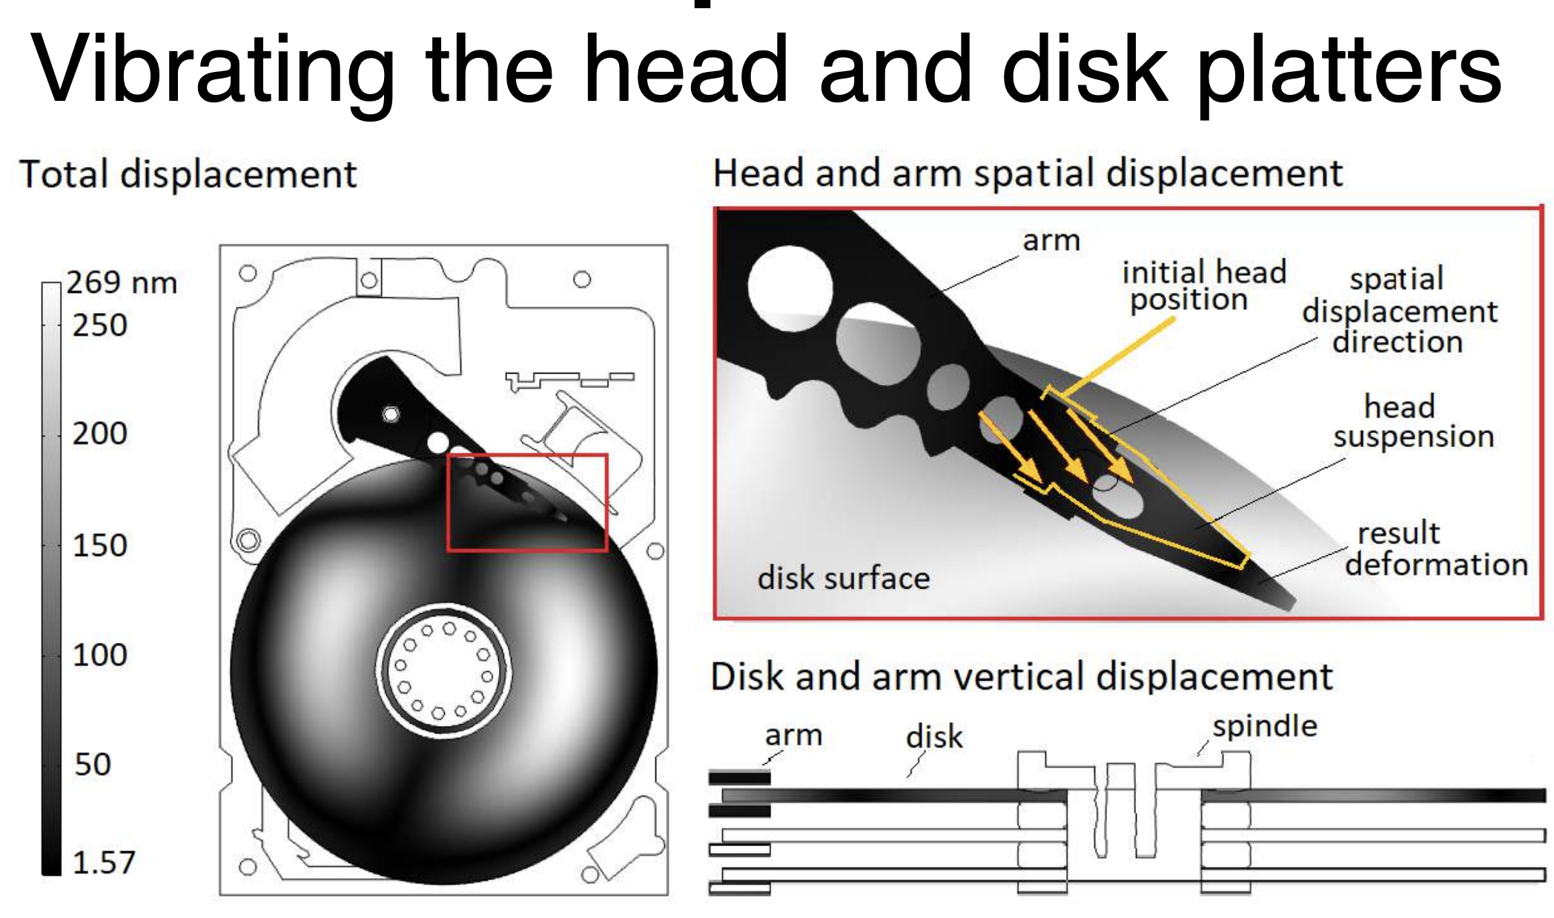
Why the Attack Can Succeed

Slide 28
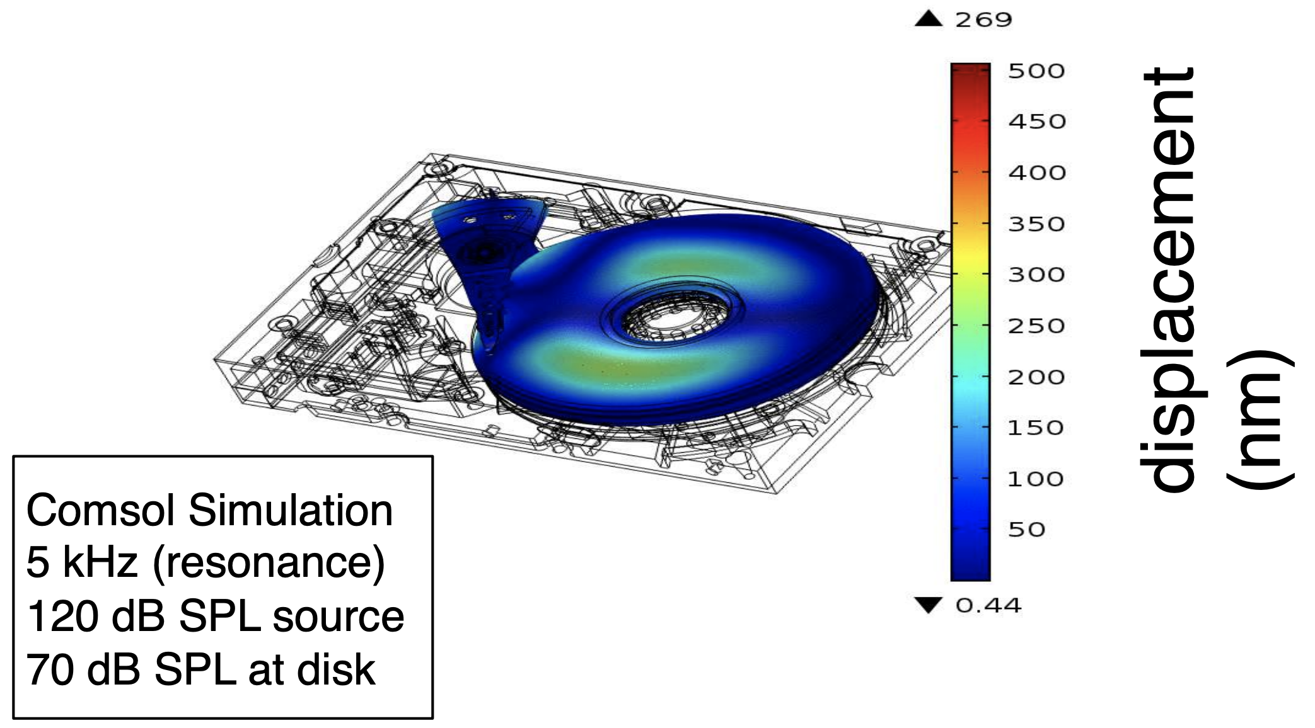
Sound distorts the HDD

Slide 29
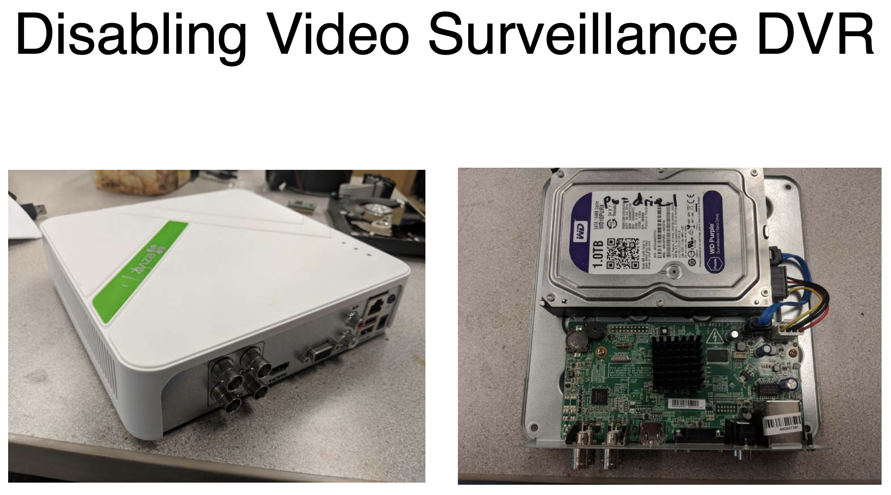
Attack Example

Slide 30
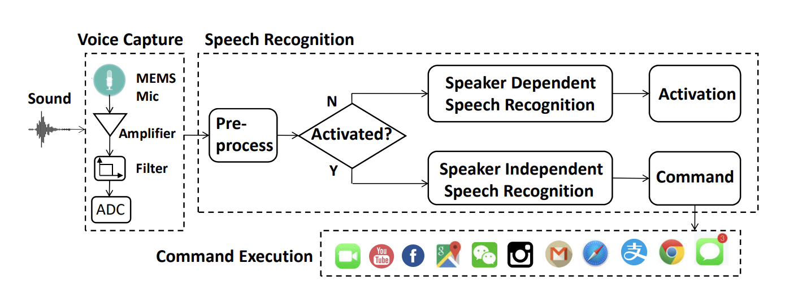
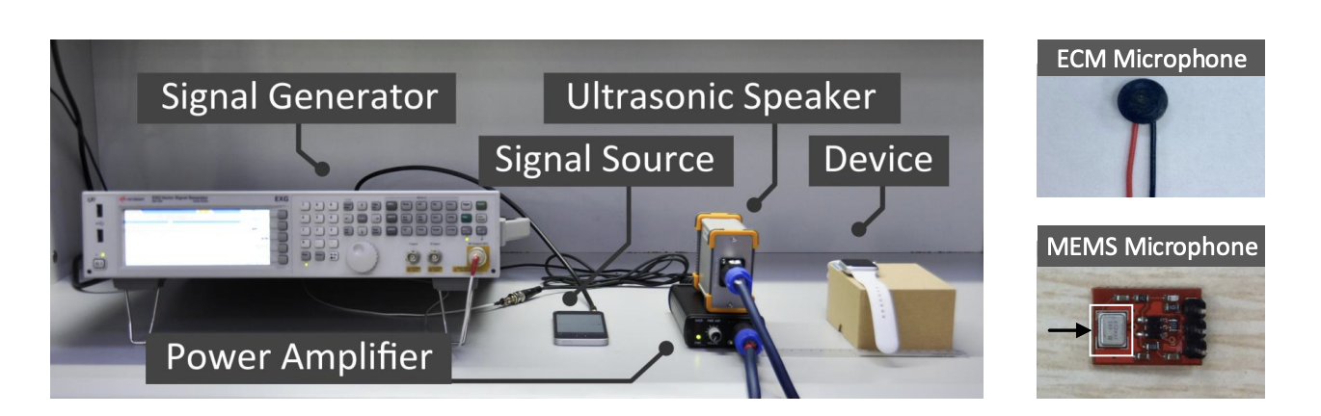
Example 4: Dolphin Attack
“DolphinAttack modulates voice commands on ultrasonic carriers (e.g., f > 20 kHz) to achieve inaudibility. By leveraging the nonlinearity of the microphone circuits, the modulated lowfrequency audio commands can be successfully demodulated, recovered, and more importantly interpreted by the speech recognition systems.”
https://www.youtube.com/watch?v=21HjF4A3WE4&ab_channel=guomingzhang
DolphinAttack: Inaudible Voice Commands by Guoming etal, CCS 2017

Slide 31
Common Types of Security & Privacy Issues
Sensor Security
Acoustic Security
Machine Learning Security

Slide 32
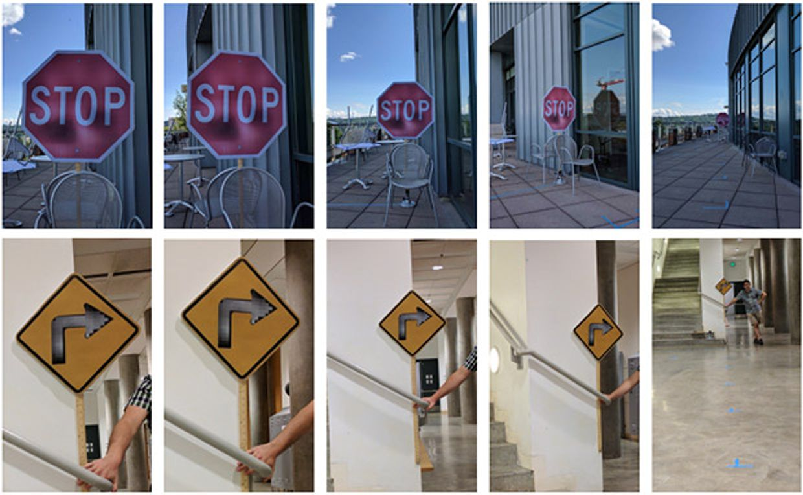
Example 5: Adversarial Machine Learning
Subtle perturbations cause a neural network to misclassify stop signs as speed limit 45 signs, and right turn signs as stop signs.
Images by EVTIMOV ET AL

Slide 33
Common Types of Security & Privacy Issues
Sensor Security
Acoustic Security
Machine Learning Security
Smart Things (e.g., Home) Security

Slide 34
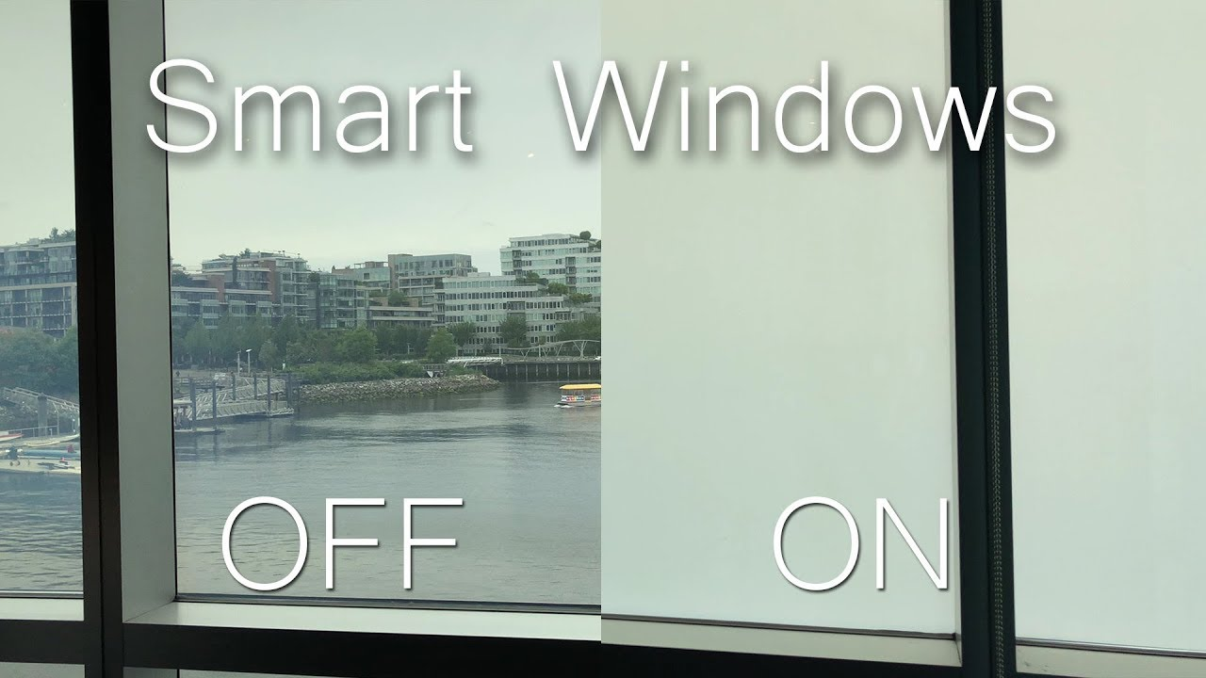
Example 5: Smart Windows
Many windows are smart enough to automatically open when the outdoor
temperature and humidity are so comfortable … may at 2AM
https://www.smartfenestra.com/products

Slide 35
Open Thoughts
Defenses?

